Slide 1
Customer Analytics Subset Selection, LASSO, Decision Trees & Random Forests
George Knox

Slide 2
Subset selection
reading link:
ISLR Ch. 6.1-2

Slide 3
From last lecture
What we want
What we got
OOS error
Deviance
= overfitting
IS error
Simple
Complex
Model Complexity
How do we systematically search for the best model?
Notes:
Picked a few models and tested them. How do we search over all possible models?
Instead want a path of models

Slide 4
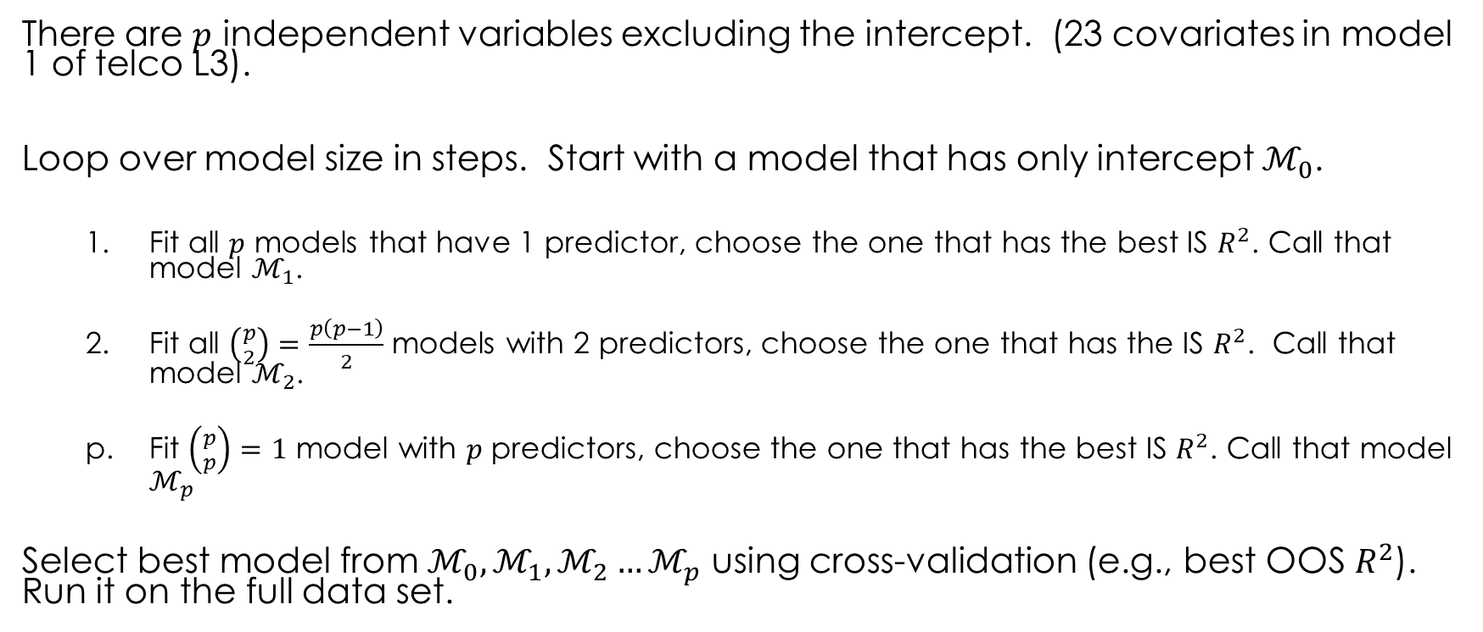
Best subset
There are $p$ independent variables excluding the intercept. (23 covariates in model 1 of telco L3).
Loop over model size in steps. Start with a model that has only intercept $ℳ_{0}$.
Fit all $p$ models that have 1 predictor, choose the one that has the best IS $R^{2}$. Call that model $ℳ_{1}$.
Fit all $\left({p \atop 2}\right)=\frac{p\left(p−1\right)}{2}$ models with 2 predictors, choose the one that has the IS $R^{2}$. Call that model $ℳ_{2}$.
Fit $\left({p \atop p}\right)=1$ model with $p$ predictors, choose the one that has the best IS $R^{2}$. Call that model $ℳ_{p}$
Select best model from ${ℳ_{0}, ℳ}_{1},ℳ_{2}…ℳ_{p}$ using cross-validation (e.g., best OOS $R^{2}$). Run it on the full data set.
Notes:
2^23 > 8 mil
Brute force: enumerate all possible models. Computationally very difficult.
Comparing models of the same size we don’t really run into OF. But comparing models different size we need CV.

Slide 5
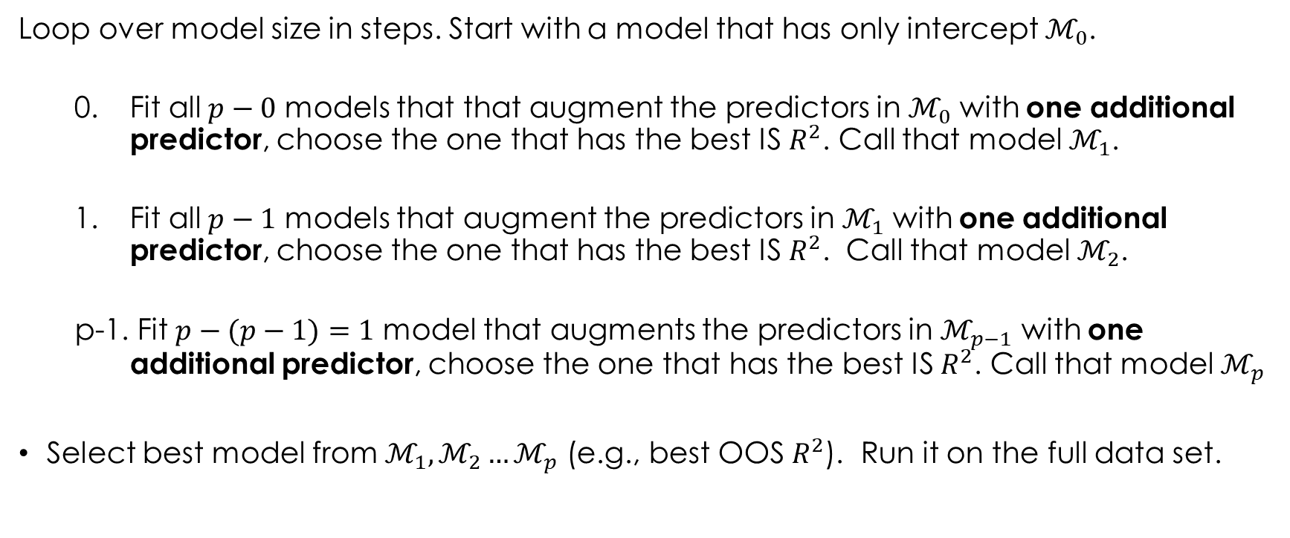
Forward stepwise regression
Loop over model size in steps. Start with a model that has only intercept $ℳ_{0}$.
0. Fit all $p−0$ models that that augment the predictors in $ℳ_{0}$ with one additional predictor, choose the one that has the best IS $R^{2}$. Call that model $ℳ_{1}$.
Fit all $p−1$ models that augment the predictors in $ℳ_{1}$ with one additional predictor, choose the one that has the best IS $R^{2}$. Call that model $ℳ_{2}$.
p-1. Fit $p−(p−1)=1$ model that augments the predictors in $ℳ_{p−1}$ with one additional predictor, choose the one that has the best IS $R^{2}$. Call that model $ℳ_{p}$
Select best model from $ℳ_{1},ℳ_{2}…ℳ_{p}$ (e.g., best OOS $R^{2}$). Run it on the full data set.
Notes:
Guided search over the model space. Greedy strategy: do what’s best now
p (p-1)/2 + 1. 254 if p = 23. Considerable savings.

Slide 6
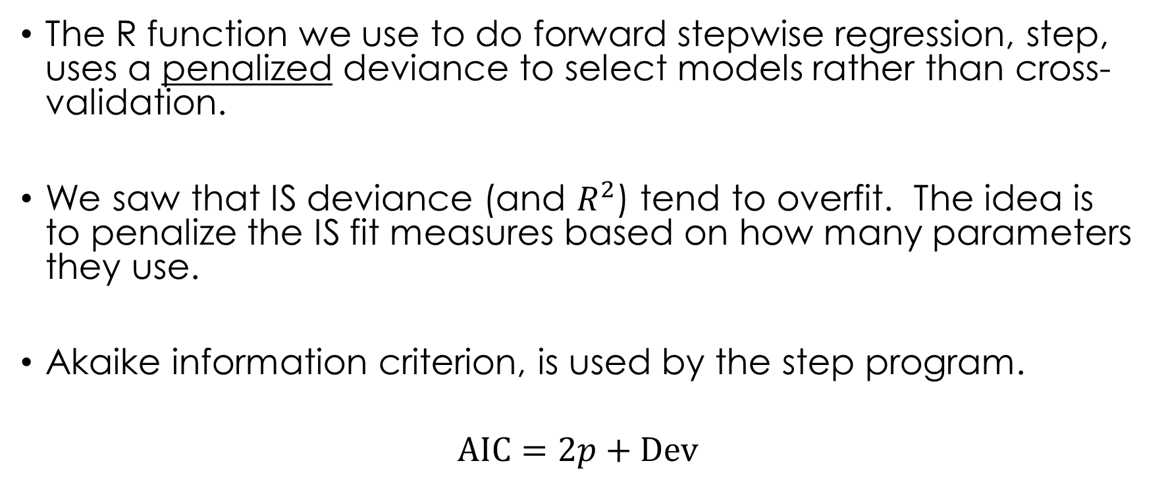
Alternative to CV
The R function we use to do forward stepwise regression, step, uses a penalized deviance to select models rather than cross-validation.
We saw that IS deviance (and $R^{2}$) tend to overfit. The idea is to penalize the IS fit measures based on how many parameters they use.
Akaike information criterion, is used by the step program.
$$\text{AIC}=2p+\text{Dev}$$

Slide 7
Telco data set
Step Df Deviance Resid. Resid.
Df Dev AIC
1 NA NA 7031 8143 8145
2 + Contract -2 1380.83 7029 6763 6769
3 + InternetService -2 413.97 7027 6349 6359
4 + tenure -1 284.48 7026 6064 6076
5 + PaymentMethod -3 53.93 7023 6010 6028
6 + PaperlessBilling -1 33.72 7022 5976 5996
7 + OnlineSecurity -1 27.40 7021 5949 5971
8 + TotalCharges -1 29.20 7020 5920 5944
9 + PhoneService -1 25.16 7019 5895 5921
10 + TechSupport -1 22.58 7018 5872 5900
11 + MonthlyCharges -1 11.31 7017 5861 5891
12 + OnlineBackup -1 11.41 7016 5849 5881
13 + SeniorCitizen -1 8.92 7015 5840 5874
14 + MultipleLines -1 4.62 7014 5836 5872
15 + Dependents -1 3.32 7013 5832 5870
16 + DeviceProtection -1 2.61 7012 5830 5870
Notes:
Step 1: intercept only.
Resid. Df: how many coefficients estimated
Adds coefficients that decreases deviance most (same as increase R2); first is contract.
8143 – 1380 = 6763.

Slide 8
Problems with forward selection
Time: Takes about 10 seconds for 7000 responses 20 covariates.
Unstable: small changes in the data lead to large differences in model selection
Alternative: estimate all coefficients but shrink the estimates towards zero.

Slide 9
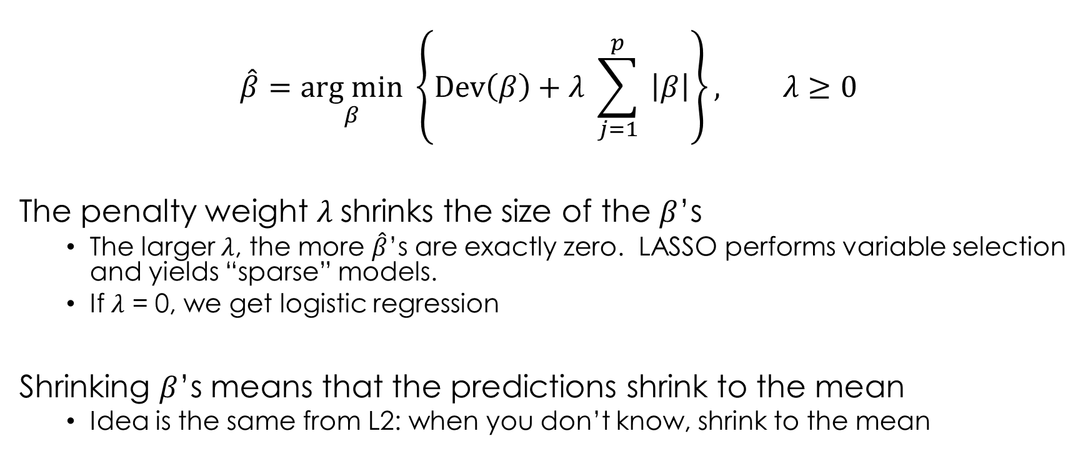
Regularization: LASSO
Penalty term
$$\hat{β}=\underset{β}{\text{arg} \text{min}} \left\{\text{Dev}\left(β\right)+λ \sum_{j=1}^{p}{ \left|β\right|}\right\}, λ≥0$$
The penalty weight $λ$shrinks the size of the $β$’s
The larger $λ$, the more $\hat{β}$’s are exactly zero. LASSO performs variable selection and yields “sparse” models.
If $λ$ = 0, we get logistic regression
Shrinking $β$’s means that the predictions shrink to the mean
Idea is the same from L2: when you don’t know, shrink to the mean
Notes:
Terms:
Deviance is -2*log likelihood -> same as logistic with out penalty term.
Penalty term shrinks close to zero.
L1 penalty: sum of absolute values of vector.
Minimize deviance is same as max. loglikelihood.
Stability

Slide 10

Absolute value
$$\left|β\right|$$
The shape of the penalty function means that some coefficients will be exactly zero
Notes:
You can think of this as a Bayesian prior with a large probability that coefficient is precisely zero.

Slide 11
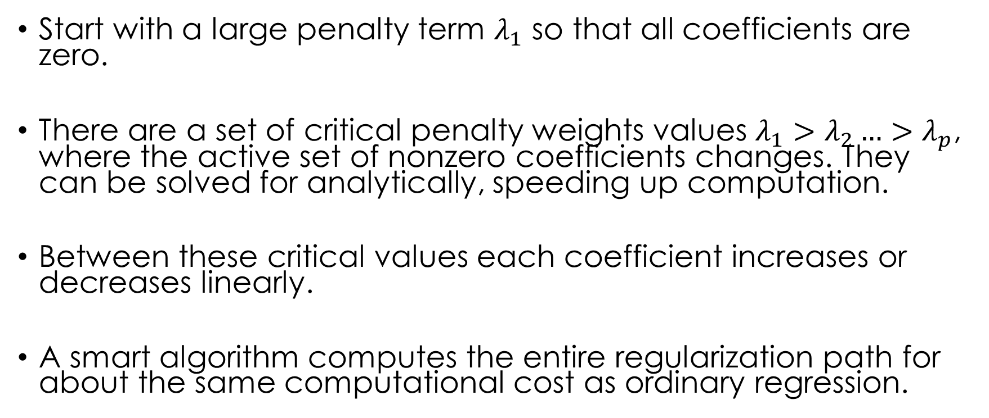
Regularization path
Start with a large penalty term $λ_{1}$ so that all coefficients are zero.
There are a set of critical penalty weights values $λ_{1}>λ_{2}…>λ_{p}$, where the active set of nonzero coefficients changes. They can be solved for analytically, speeding up computation.
Between these critical values each coefficient increases or decreases linearly.
A smart algorithm computes the entire regularization path for about the same computational cost as ordinary regression.
Notes:
Stable: small changes

Slide 12




[1] "telco.tenure" "telco.MonthlyCharges"
[3] "telco.TotalCharges" "SeniorCitizen"
[5] "PartnerYes" "DependentsYes"
[7] "PhoneServiceYes" "MultipleLinesYes"
[9] "InternetServiceFiber.optic" "InternetServiceNo"
[11] "OnlineSecurityYes" "OnlineBackupYes"
[13] "DeviceProtectionYes" "TechSupportYes"
[15] "StreamingTVYes" "StreamingMoviesYes"
[17] "ContractOne.year" "ContractTwo.year"
[19] "PaperlessBillingYes" "PaymentMethodCredit.card..automatic."
[21] "PaymentMethodElectronic.check" "PaymentMethodMailed.check"
Number of non-zero coefficients
$λ$for which all beta = 0
$$λ=\exp\left(−8\right)<.001$$
$$λ=\exp\left(−2\right)=.14$$
Small penalty cost
$$\log\left(λ\right)$$
Large penalty cost
Stability means this scales to many big data app’s
Notes:
Beta is smooth in lambda

Slide 13
Choose lambda such that K-fold CV deviance is minimized
Number of non-zero coefficients
Deviance divided by number of obs

Slide 14
That model is
(Intercept) 0.0480
telco.tenure -0.0548
telco.MonthlyCharges .
telco.TotalCharges 0.2604
SeniorCitizen 0.2136
PartnerYes .
DependentsYes -0.1475
PhoneServiceYes -0.5920
MultipleLinesYes 0.2475
InternetServiceFiber.optic 0.7701
InternetServiceNo -0.7711
OnlineSecurityYes -0.3918
OnlineBackupYes -0.1557
DeviceProtectionYes -0.0359
TechSupportYes -0.3688
StreamingTVYes 0.1972
StreamingMoviesYes 0.2067
ContractOne.year -0.6548
ContractTwo.year -1.3247
PaperlessBillingYes 0.3402
PaymentMethodCredit.card..automatic. -0.0735
PaymentMethodElectronic.check 0.3163
PaymentMethodMailed.check -0.0352
Note no standard errors
2 variables didn’t make the cut
Notes:
No standard errors

Slide 15
Decision Trees
Reading:
BKN Ch. 17
ISLR Ch. 8.1

Slide 16
Motivation
We want a model that is simple to understand and communicate

Slide 17
Closer look
Parent-child structure
Root node
student = no
student = yes
Leaf
Every leaf (terminal node) has a prediction: the average
Notes:
## 1) root 4952 4000 no response ( 1 0 )
## 2) student: no 2334 0 no response ( 1 0 ) *
## 3) student: yes 2618 3000 no response ( 1 0 )
## 6) F < 2.5 986 500 no response ( 1 0 )
## 12) F < 1.5 354 0 no response ( 1 0 ) *
## 13) F > 1.5 632 400 no response ( 1 0 ) *
## 7) F > 2.5 1632 2000 no response ( 1 0 )
## 14) F < 4.5 243 300 no response ( 1 0 ) *
## 15) F > 4.5 1389 2000 no response ( 1 0 ) *

Slide 18
How it fits the data
Leaf (terminal) nodes## Classification tree:
## tree(formula = respmail ~ ., data = subset(ebeer, select = c(respmail,
## F, student)), mindev = 0.005)
## Number of terminal nodes: 5
## Residual mean deviance: 0.505 = 2500 / 4950
## Misclassification error rate: 0.124 = 616 / 4952
How does it decide where to split?

Slide 19
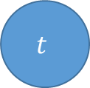

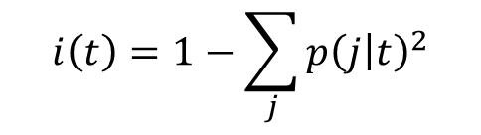

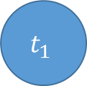
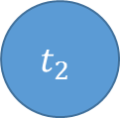
CRT: Gini impurity
Gini impurity is a measure of how often a randomly chosen element from the set would be incorrectly labeled if it was randomly labeled according to the distribution of labels in the subset.
$$t$$
$$t_{1}$$
$$t_{2}$$
Gini index of impurity
Response | 100 | 100
No response | 0 | 100
$$i\left(t\right)=1−\sum_{j}{p{\left(j | t\right)}^{2}}$$
$$i\left(t_{1}\right)=1−1^{2}−0^{2}=0$$
$$i\left(t_{2}\right)=1−{0.5}^{2}−{0.5}^{2}=0.5$$
Minimal impurity
Maximal impurity

Slide 20
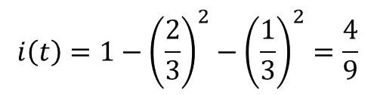
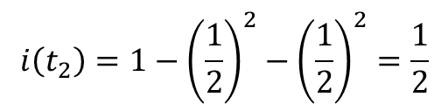

Splitting algorithm: CRT
$$t$$
Response | 200
No response | 100
$$i\left(t\right)=1−{\left(\frac{2}{3}\right)}^{2}−{\left(\frac{1}{3}\right)}^{2}=\frac{4}{9}$$
$$t_{1}$$
$$t_{2}$$
Response | 100 | 100
No response | 0 | 100
$$i\left(t\right)=1−\sum_{j}{p{\left(j | t\right)}^{2}}$$
$$i\left(t_{2}\right)=1−{\left(\frac{1}{2}\right)}^{2}−{\left(\frac{1}{2}\right)}^{2}=\frac{1}{2}$$
$$i\left(t_{1}\right)=1−1^{2}−0^{2}=0$$

Slide 21
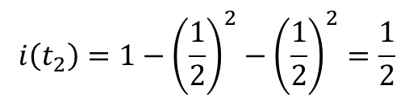

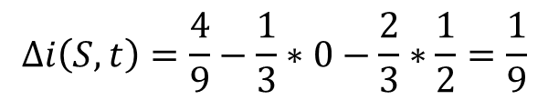
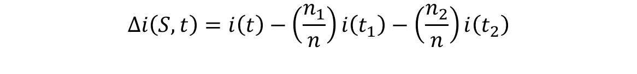
Splitting algorithm: CRT
$$t$$
Response | 200
No response | 100
$$i\left(t\right)=1−{\left(\frac{2}{3}\right)}^{2}−{\left(\frac{1}{3}\right)}^{2}=\frac{4}{9}$$
$$t_{1}$$
$$t_{2}$$
Response | 100 | 100
No response | 0 | 100
$$i\left(t\right)=1−\sum_{j}{p{\left(j | t\right)}^{2}}$$
$$i\left(t_{2}\right)=1−{\left(\frac{1}{2}\right)}^{2}−{\left(\frac{1}{2}\right)}^{2}=\frac{1}{2}$$
$$i\left(t_{1}\right)=1−1^{2}−0^{2}=0$$
Decrease in impurity by split S
$$Δi\left(S,t\right)=i\left(t\right)−\left(\frac{n_{1}}{n}\right)i\left(t_{1}\right)−\left(\frac{n_{2}}{n}\right)i\left(t_{2}\right)$$
$$Δi\left(S,t\right)=\frac{4}{9}−\frac{1}{3}∗0−\frac{2}{3}∗\frac{1}{2}=\frac{1}{9}$$

Slide 22
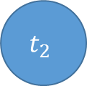
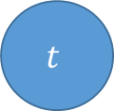
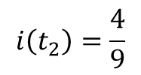
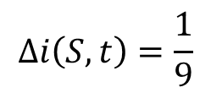

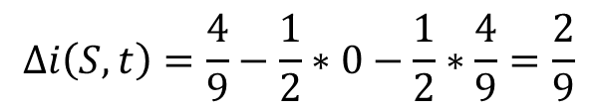
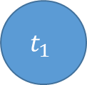
Splitting algorithm: CRT
$$t$$
$$t$$
Potential split 1
Potential split 2
$$t_{1}$$
$$t_{2}$$
$$t_{1}$$
$$t_{2}$$
Response | 100 | 100
No response | 0 | 100
Response | 150 | 50
No response | 0 | 100
$$i\left(t_{1}\right)=0$$
$$i\left(t_{2}\right)=\frac{4}{9}$$
$$Δi\left(S,t\right)=\frac{1}{9}$$
$$Δi\left(S,t\right)=\frac{4}{9}−\frac{1}{2}∗0−\frac{1}{2}∗\frac{4}{9}=\frac{2}{9}$$

Slide 23
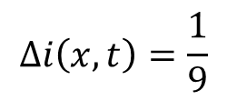
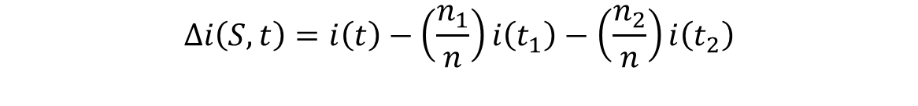
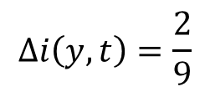
Splitting algorithm: CRT
$$Δi\left(S,t\right)=i\left(t\right)−\left(\frac{n_{1}}{n}\right)i\left(t_{1}\right)−\left(\frac{n_{2}}{n}\right)i\left(t_{2}\right)$$
$$Δi\left(x,t\right)=\frac{1}{9}$$
Decrease in impurity by split 1 at node t
$$Δi\left(y,t\right)=\frac{2}{9}$$
Decrease in impurity by split 2 at node t
Decrease in impurity is larger when we split with Y than X, so choose Y split.
We stop when the decrease is smaller than some threshold, or when leaves are small (few observations)

Slide 24
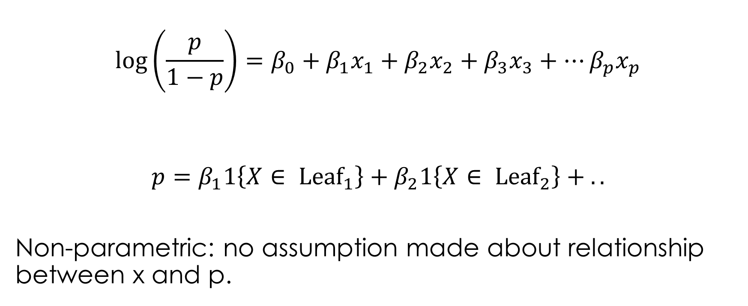
Decision Tree vs. Logistic regression
$$\log\left(\frac{p}{1−p}\right)=β_{0}+β_{1}x_{1}+β_{2}x_{2}+β_{3}x_{3}+…β_{p}x_{p}$$
$$p=β_{1}1\left\{X∈ \text{Lea}{\text{f}}_{1}\right\}+β_{2}1\left\{X∈ \text{Lea}{\text{f}}_{2}\right\} + ..$$
Non-parametric: no assumption made about relationship between x and p.

Slide 25
We can fit the in-sample data arbitrarily well
We lower the threshold for improvement to zero, the tree grows as complex as the data.

Slide 26
We can fit the in-sample data arbitrarily well
What problems do you foresee?

Slide 27
Decision trees
Advantages:
Interpretability
Nonparametric: more flexible than logistic regression
Disadvantages:
Unstable -> irrelevant variables can change the model results
Tendency to overfit the data

Slide 28
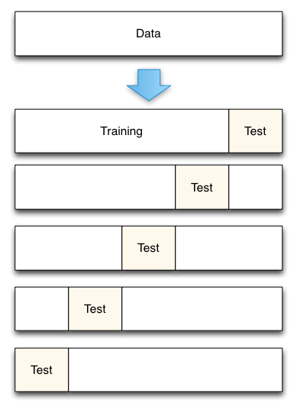
K-fold cross validation
Here K = 5.
Data randomly split into 5 equally sized groups of 20% each.
4 groups used to fit, one group to validate.
Repeat so that all data is used.

Slide 29
Comparing OOS error
No improvement over 4

Slide 31
Random Forests
Optional further reading link:
ISLR Ch. 8.2

Slide 32
Extension: bagging
Idea: averaging a set of observations reduces variance
One tree has high variance, but an average of many trees will have low variance
Bagging = bootstrap aggregation
From L1: bootstrap sampling = take a sample of same size from the original dataset, but with replacement
Same observation can occur multiple times

Slide 33
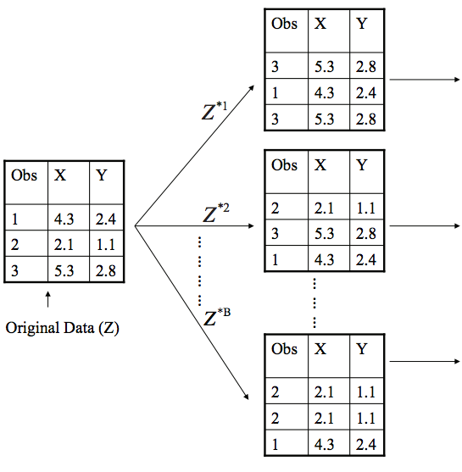



Create B bootstrapped samples
For each b = 1, .. B samples,
estimate a tree
$$\text{T}\text{ree}\left(Z^{∗1}\right)$$
Final model is an
average over all B trees.
$$\text{T}\text{ree}\left(Z^{∗2}\right)$$
$$\text{T}\text{ree}\left(Z^{∗B}\right)$$

Slide 34
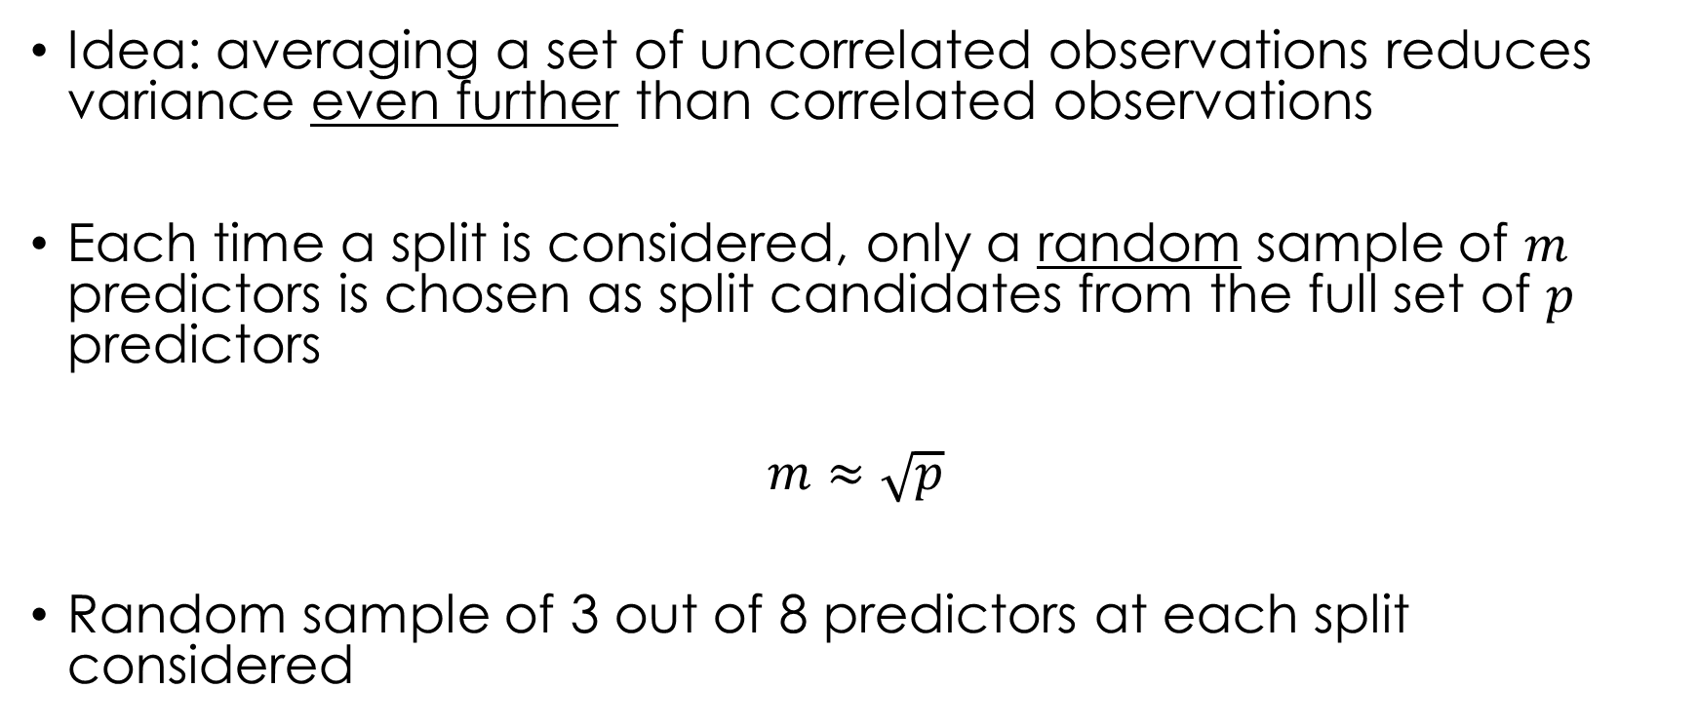
Extension: random forest
Idea: averaging a set of uncorrelated observations reduces variance even further than correlated observations
Each time a split is considered, only a random sample of $m$ predictors is chosen as split candidates from the full set of $p$ predictors
$$m≈\sqrt{p}$$
Random sample of 3 out of 8 predictors at each split considered

Slide 35







example
Random sample of $m=3$ predictors
$$\{R,gender, student\}$$
$$R≤1$$
$$R>1$$
Every split, randomly choose 3
$$\{F,gender, M\}$$
$$F≤1$$
$$F>1$$
If we choose $m=p$, then random forest is the same as bagging

Slide 36
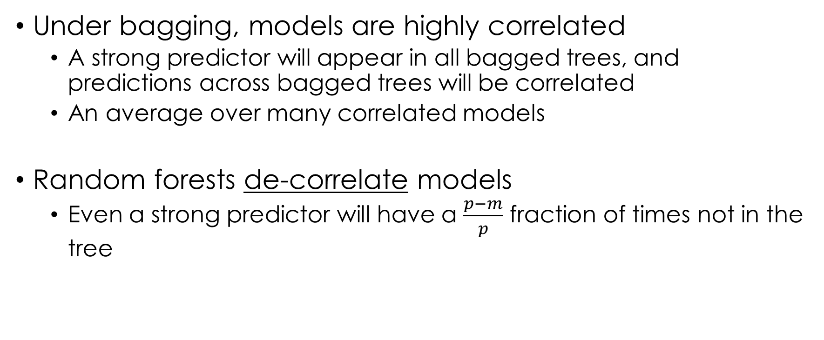
Why?
Under bagging, models are highly correlated
A strong predictor will appear in all bagged trees, and predictions across bagged trees will be correlated
An average over many correlated models
Random forests de-correlate models
Even a strong predictor will have a $\frac{p−m}{p}$ fraction of times not in the tree

Slide 37
Random forest variable importance

